Slide 1
Rotor Hub And Pitch System
Group Members :
Dhruvin Kakdiya
Adharsh Pappinisseri Veedu
Muthu Thirunavukarasu
Syed Mohammed Sikandar
Week number : 08
Date: 18/11/2025
Supervisor: Prof. Peter Quell

Slide 2
List of contents
Bolt calculations
Additional flange design
Backup Supply Systems
CAD Model & Drive Assembly
Adharsh Pappinisseri Veedu

Slide 3
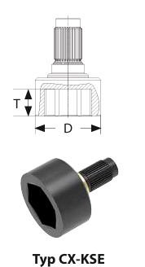
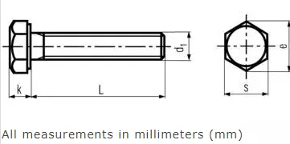
Bolt calculations
Hydraulic Torque wrench for M36 bolts
[1] ITH
K | 22.5 mm
e | 60.79 mm
S | 55 mm
Tool specification ITH TYPE CX5 (SW 55)
Tool diameter D= 87 mm
T= 36 MM
[2] ITAFASTNER
Adharsh Pappinisseri Veedu

Slide 4
For calculate no. of bolts we have taken d = Tool diameter (D)/2 + Width across corners (e)/2 + 1mm for clearance
= 87/2 mm + 60.79/2 mm + 1 mm
d ≈ 75 mm
* No. of bolts in outer ring (where outer BCD 3400 mm) N out = 𝜋 * 3400 mm / 75 mm = 142 bolts
* No. of bolts in inner ring (where outer BCD 2994 mm) N in = 𝜋 * 2994 mm / 75 mm = 125 bolts
Adharsh Pappinisseri Veedu

Slide 5
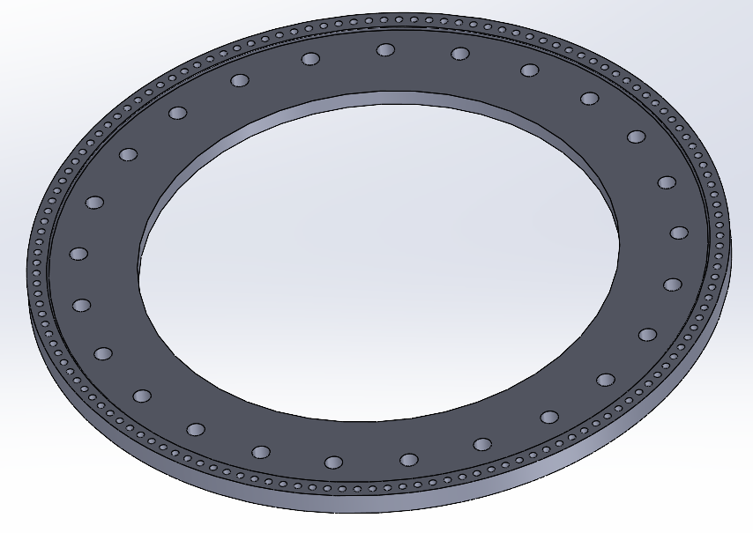
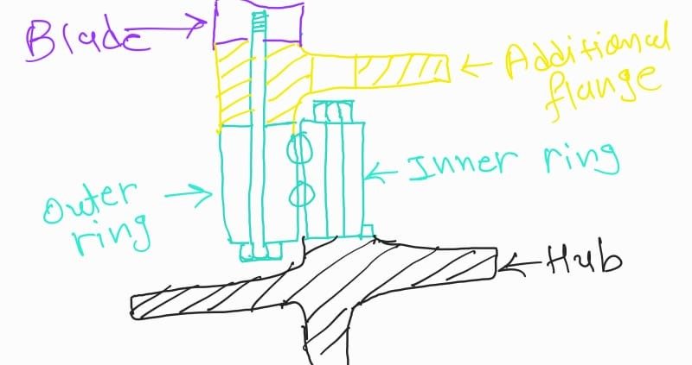
Additional flange design
25 Holes for inspection of Bolts on inner ring
Own sketch
Holes for Bolt connection between Outer ring and Blade
Own Design
Adharsh Pappinisseri Veedu

Slide 6
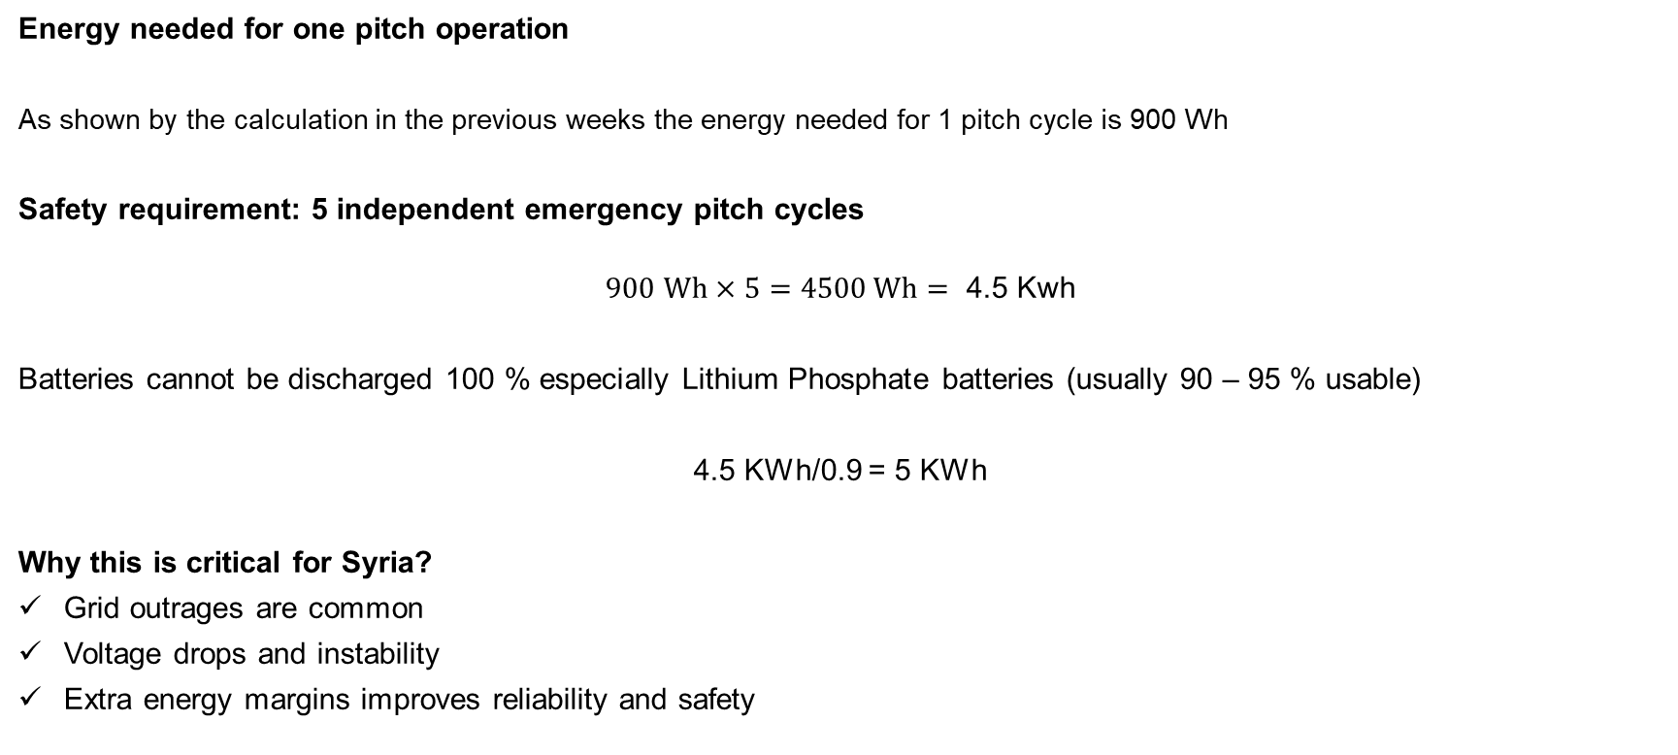
Backup supply system
Energy needed for one pitch operation
As shown by the calculation in the previous weeks the energy needed for 1 pitch cycle is 900 Wh
Safety requirement: 5 independent emergency pitch cycles
$$900 Wh×5=4500 Wh= \text{4.5 }\text{Kwh}$$
Batteries cannot be discharged 100 % especially Lithium Phosphate batteries (usually 90 – 95 % usable)
4.5 KWh/0.9 = 5 KWh
Why this is critical for Syria?
Grid outrages are common
Voltage drops and instability
Extra energy margins improves reliability and safety

Slide 7
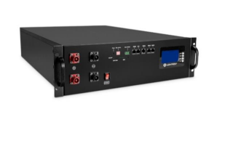
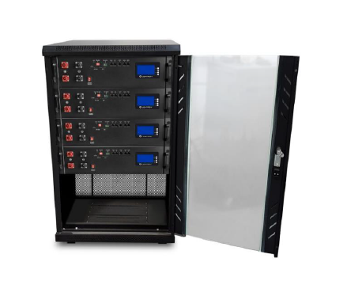
Backup Supply System
[3] [4]
We have Chosen the Liontron LX48-100 - 48V 100Ah and it offers 5120 Wh as per our energy needs.
Discharge temperature - 20 °C to +60 °C
Storage temperature - -20 °C to +60 °C
Max ambient temperature - +60 °C
Weight - 43.6 Kg
Dimensions – 618 * 430 * 133 ( L*W*H)
Sikandar

Slide 8
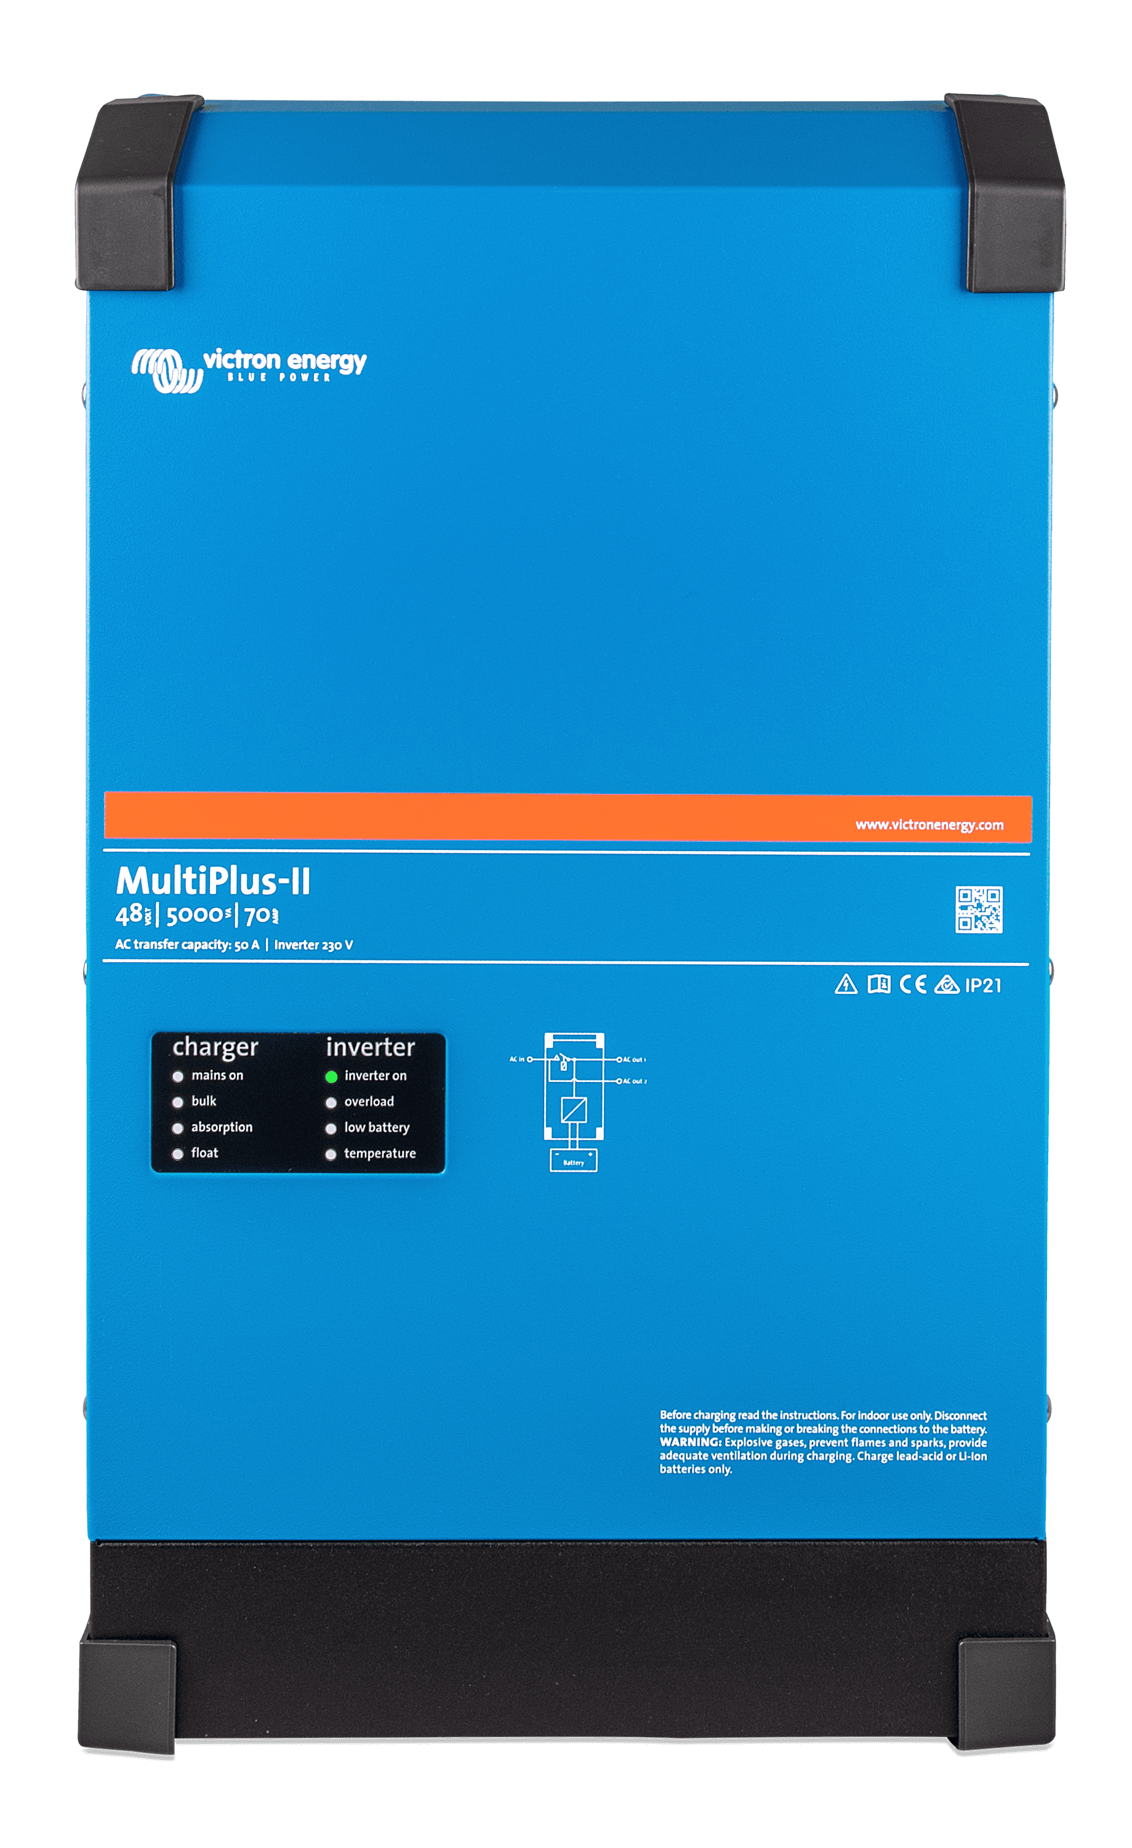
Backup Supply System
We chose the Victron MultiPlus-II 48V 3000VA inverter for the following
reasons
Battery nominal voltage (51.2V) matches inverter input rating (48V)
Inverter supports Configurable battery type and LiFePO4 Charge profile
Battery capacity (100 Ah) can be safely charged by the inverter ( Charger capable of 30 – 70 A)
It works with 48 V battery bank and provides AC output for loads or backup system
[5]
Sikandar

Slide 9
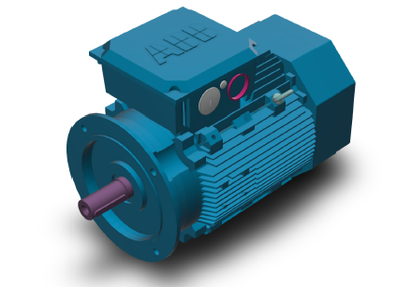
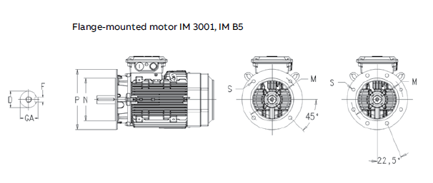
CAD Model
Motor:
Dimensions
Product Net Depth / Length: 822 mm
Product Net Height: 528 mm
Product Net Width: 413 mm
Product Net Weight: 304 kg
Gross Weight: 314 kg
Input Voltage (Uin): 400 V
Output Power: 22 kW
Torque : 210 Nm
Frame Size: 200 IEC
Frame Material:Cast Iron
1

Slide 10
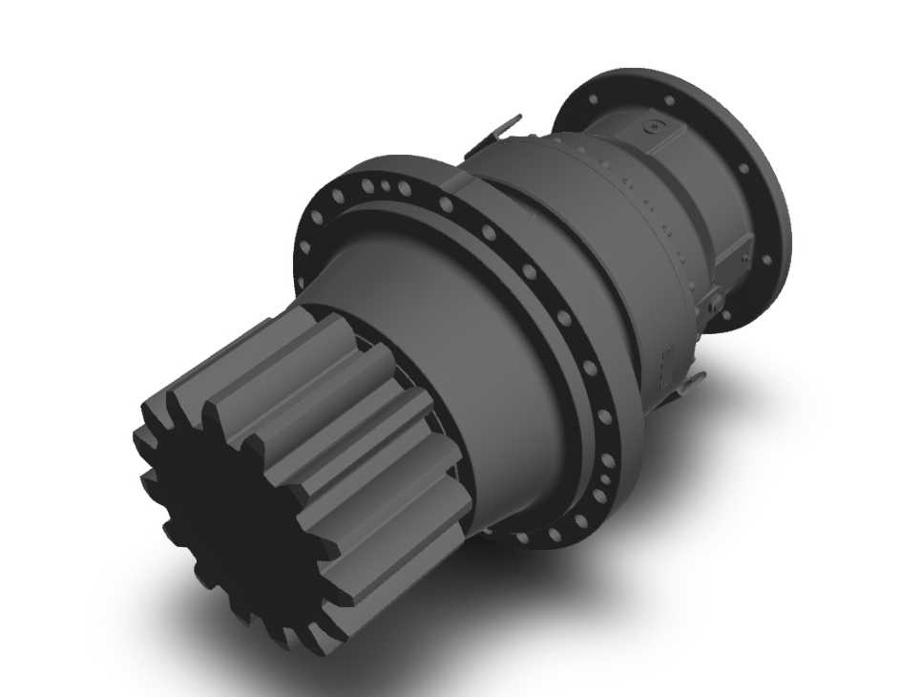
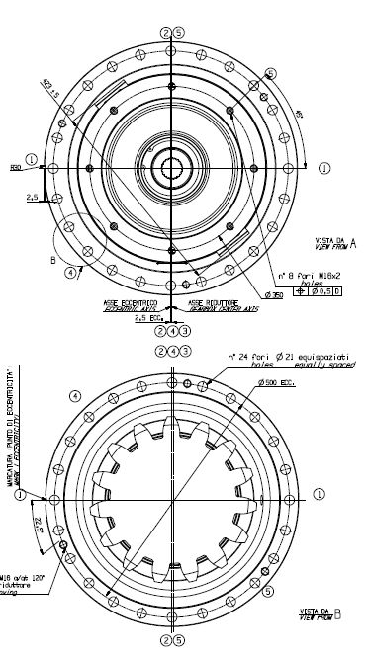
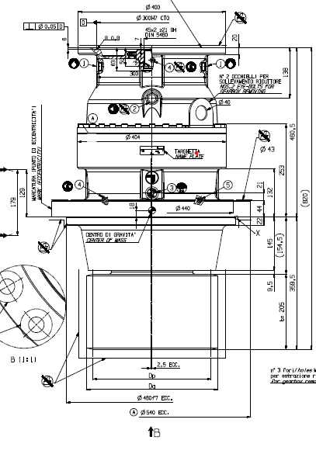
Gear box
Required peak pinion torque: 61.5 KNm .
711 TW with 80,000 Nm range
3 stage planetary Gearbox
Product Net Weight: 304 kg
Material: 20MnCr5 is a case hardening alloy steel

Slide 11
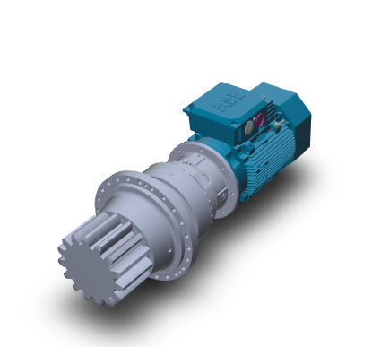
Drive Assembly

Slide 12
Bibliography
ITH. (n.d.). ITH Hydraulic Torque Wrenches Catalog. Retrieved November 27, 2025, from www.ITH.de/schraubwerkzeuge/hydraulische-drehmomentschrauber [27.11.2025]
ITA BOLTS https://itafasteners.com/products-bolts-hex-head-anchor-bolts.php [27.11.2025 ]
Manual https://liontron.com/download/german/list_LIONTRON-Datenblatt_LX48-100-1.pdf [25.11.25]
Inverter https://www.victronenergy.com/upload/documents/Manual-MultiPlus-II-48V-3k,-5k,-8k,-10k-15k-230V-(AUS)-EN--(P).pdf [26.11.25]

